Slide 1




File Handling - Introduction
COBOL has the ability to clearly, accurately, and quickly handle data files.
COBOL uses some terms that you need to understand in order to discuss data file access…
File. Is made up of individual records.
Record. Collection of individual fields or data items.
FEU – EAST ASIA COLLEGE
Information Technology Department

Slide 2
Remember….
A file is simply a group of records.
The format or formats of the records in the file are defined in your COBOL program.
A record is a Group Level item, made up of elementary data items or groups of elementary data items.
The definition for a record is called record layout, or record description.
The layouts of the records used by various files are specified in the Data Division.

Slide 3
Sequential File
A file that is accessed sequentially; that is, the records are retrieved from the file in order, from the first record in the file to the last. Records cannot be retrieved out of order. You may not jump ahead in the file, nor may you go backward.
When creating, or writing, you must write the records in order. The physical order of the records in the file is the order in which they were written.

Slide 4
Types of Sequential File:
Line Sequential Files. Regular text files, created by Notepad or some other text editor.
Contain records of varying length.
Trailing space data in the record is not written (it is truncated), thus saving space.
Records are terminated with a platform-dependent delimiter.

Slide 5
Line Sequential Files…
Good for reading or writing data that the user may edit with a standard text editor.
If your files are for use only by your COBOL program and are not to be shared with other systems, you should not use Line Sequential files.

Slide 6
Record Sequential File
The default type. Normally referred to simply as a Sequential file.
The records are not delimited.
Each record in the file is adjacent to its immediate neighbors.

Slide 7
Connecting Your Program to a File
To access a sequential file, you must establish a connection between the file and your program. This process requires 2 (two) steps:
1.) Establish the hardware, file type,
organization, and filename of the file you are
accessing.
2.) Defines the layout of the records in the file.

Slide 8
The Select Statement
Connects your program to a file.
Coded in the Environment Division, under the Input-Output Section, in a paragraph titled File-Control.
An internal filename is specified in the Select statement. This name is the name by which you refer to the file in your COBOL program. The filename may be up to 30 characters long.

Slide 9
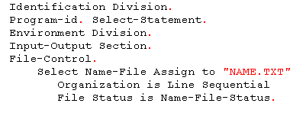
Select Statement…
Example:

Slide 10
Select Statement…
The Assign clause associates the file with a named file on your system.
The Organization clause specifies the type of file you are working with. For sequential files, the type can be Sequential or Line Sequential.
The File Status clause associates the system returned File Status with a field in the Data Division. This field is two character long and contains a status value that can be tested after every operation against the file.
Select clause starts in Area B.

Slide 11
The File Description
Describes the attributes of the file and its associated data record or records.
The only relevant line is the actual FD line. The FD is coded in the Data Division of the File Section.
The Record Description, immediately follow the FD. The FD contains the same filename as specified in the Select statement. Every file specified with a Select statement requires a File Description entry.

Slide 12
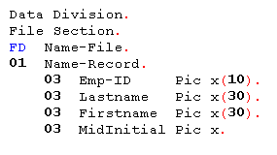
The File Description
The record description must start with an 01 Group Level item.

Slide 13
Restrictions on Record Description
The data records can contain 88 level items and Redefines clause.
Any Value clauses specified are considered comments and do not set actual values within the fields.
Level 77 may not be used.
Occurs clause may be used.

Slide 14
Opening the File (Open Input)
First step in order to use the defined file in the COBOL program.
Sequential files may be opened in 4 (four) different modes:
Mode | Description
Input | Read data from the file
Output | Write data to the file
I-O | Update records in the file
Extend | Add records to the end of the file

Slide 15

Opening the File (Open Input)
The Open will be successful if the file exists.
The status value of successful open is 00 which is stored in the data item assigned by the File Status in the Select statement. If no File status is defined, the program may end abnormally with an error reported by the runtime system.

Slide 16
Opening the File (Open Input)
Standard File Status values contain two characters. The status returned under “normal” circumstances begins with a zero.
If file does not exist and you Open it Input, the Files status returned is 35.
If you don’t want your program to report a serious file error when the file does not exist, you can code the Optional clause on the Select statement.

Slide 17
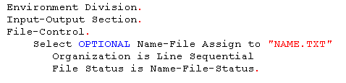
Opening the File (Open Input)
When optional is coded, the file status reported for the Open of a file that does not exist is 05 and the Open is successful.

Slide 18

Closing the File
When you are finished processing a file, you should release the file to the OS so that other programs can use it.
The filename being closed, as stated in the select statement and FD, must be specified.

Slide 19
Closing the File
The following file status values can be returned from the Close of a sequential file.
Status | Meaning
00 | Successful completion
30 | Physical error, no other information available
42 | Close issued for an unopened file
9x | Compiler-vendor defined (starts with 9 followed by compiler vendor default values)

Slide 20
Writing to the File (Open Output)
Before you can accomplish anything meaningful with a sequential file, you need to create it.
To create the file, it is opened for Output.
When a file that does not exist is opened for Output, it is created.
If it does exist, it is replaced by an empty file.
After the Open, any file status other than 00 indicates an error with the Open.

Slide 21
Writing to the File (Open Output)
File status values for Open in Output Mode:
Status | Meaning
00 | Successful completion
30 | Physical error, no other information available
9x | Compiler-vendor defined

Slide 22
Writing to the File (Open Output)
Data records are created in the file by using the Write statement.
The only required operand with the Write statement is a Record Identifier – is the one of the 01 Group level items coded under the FD.

Slide 23
Writing to the File (Open Output)
File status values from the Write statement:
Status | Meaning
00 | Successful completion
30 | Physical error, no other information available
34 | Boundary error
48 | Attempted to write to a file that is either not open or is not open in an appropriate mode for write
9x | Compiler-vendor defined

Slide 24
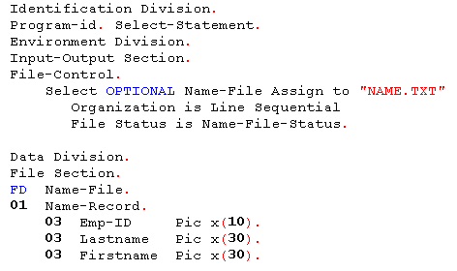
Sample Program – v1

Slide 25
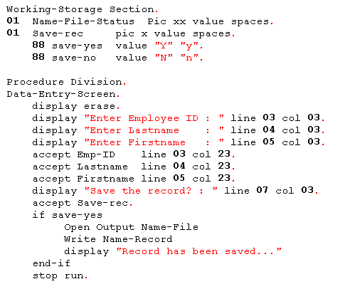

Slide 26
Sample Program – v2

Slide 27
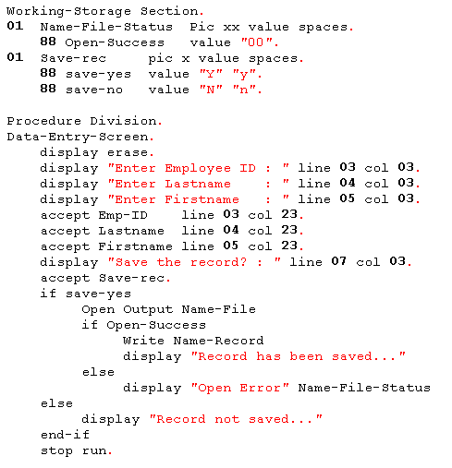

Slide 28
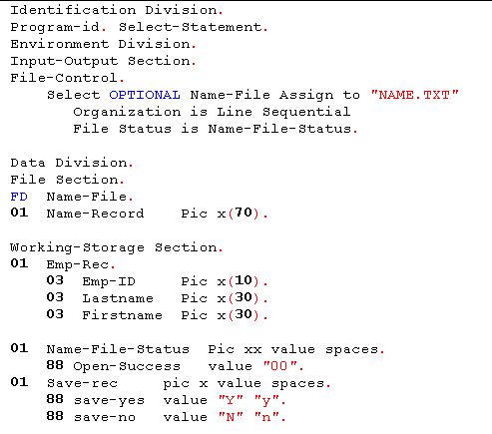
Sample Program – v3

Slide 29
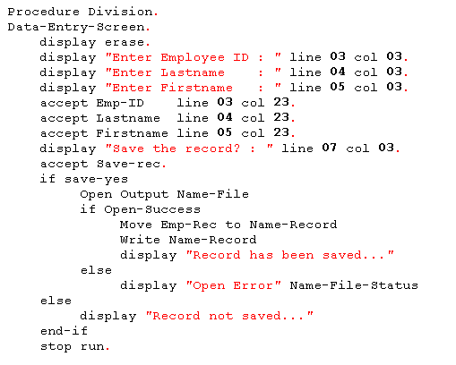

Slide 30
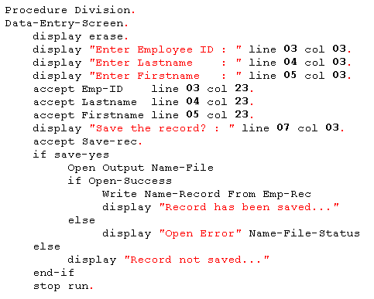
Sample Program – v4

Slide 31
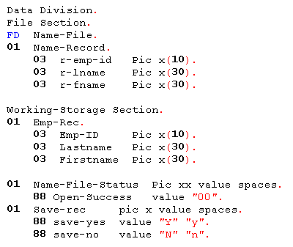
Sample Program – v5

Slide 32
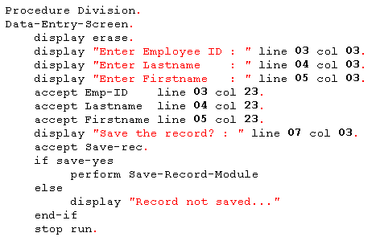

Slide 33
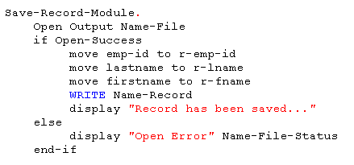

Slide 34
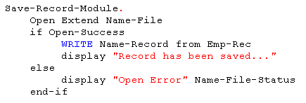
Writing to the File (Open Extend)
When the file is opened Extend, new data records written to the file are added at the end of the file.

Slide 35
Reading from the File
The first step is to Open the file for Input.
When a file is Open for Input, you may only retrieve, or read, data from the file.
You may retrieve data from an open file with the Read statement.

Slide 36
Reading from the File
Sequential files are read from the first record to the last. The Read statement returns the next record in the file and places the contents in the record description defined for the file under the FD.

Slide 37
Reading from the File
File status values for Open in Input Mode:
Status | Meaning
00 | Successful completion
05 | Successful open of an optional file that does not exist
30 | Physical error, no other information available
35 | Open failed on a non optional file. The file does not exist.
39 | The file being opened is defined differently than the definition specified in the program.
41 | The file being opened is already open.
9x | Compiler-vendor defined.

Slide 38
Reading from the File
File status values for Read:
Status | Meaning
00 | Successful completion
04 | Successful; however, the record read is not the same length as the record defined in the FD
10 | The end of the file has been reached
30 | Physical error, no other information available
46 | The Read failed because the previous Read failed
47 | A Read was attempted on a file that is not Open for Input or I-O
9x | Compiler-vendor defined

Slide 39

Reading from the File
The end-of-file condition can be detected in 2 ways:
1.) To check the file status after the Read. If it is 10, then you have reached the end of the file.
2.) To code the At End clause on the Read statement. When At End is coded, the statements after the clause are executed when an end-of-file condition is detected.

Slide 40
Reading from the File
You may also store the results of a Read statement in a data item in Working-Storage.
For the Read statement, you specify Into and the name of the data item in which you wish to store the record read.

Slide 41
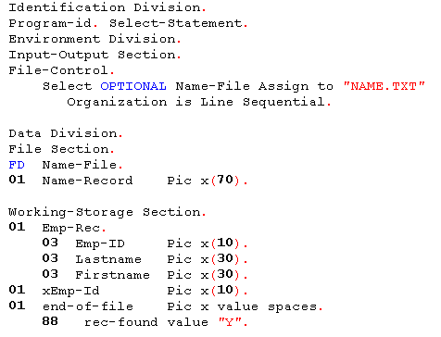
Sample Program – search a record

Slide 42
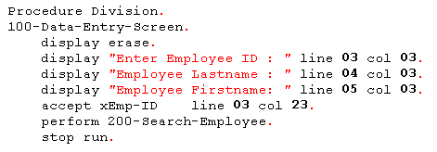

Slide 43
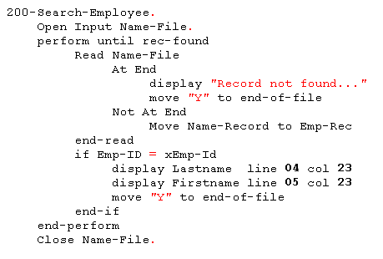

Slide 44

Updating the File (Open I-O)
Some restrictions apply to updating a Sequential file. Because Line Sequential File records can be of differing lengths and updated records are written to the original physical location, you may not update a Line Sequential File.
Necessary changes in the Select statement must be done.

Slide 45
Updating the File (Open I-O)
To update the file, you must Open it for I-O.
The file status values returned by the Open are the same as those reported for opening the file for Input.
After the file is Open, it is processed by Read statement as if it were Open for Input.
You may update a record by coding the Rewrite statement.

Slide 46
Updating the File (Open I-O)
Rewrite also supports the use of From to update the record from a data item in working-storage.
The file status values returned from a Rewrite are the same as those that are returned as the result of a Write.
You may not issue a Write statement against a Sequential file that is opened I-O.

Slide 47
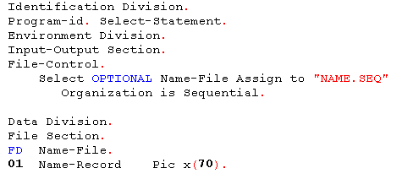
Sample Program

Slide 48
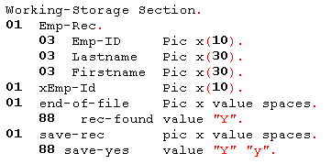

Slide 49
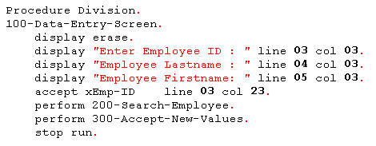

Slide 50
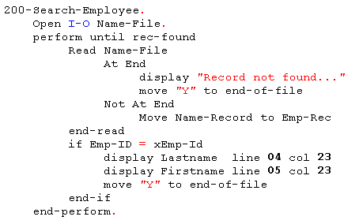

Slide 51
